Slide 1
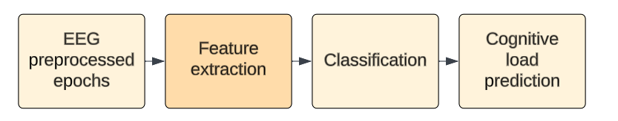
Methods: block diagram

Slide 2
Methods: Conventional features
Mean
Variance
Standard deviation
Skewness
Kurtosis
Zero crossing rate
Upper margin
Lower margin
Width
Asymmetry
Coefficient of variation
Total power
Absolute band power
Mean band power
Relative band Power
Shannon entropy
Sample entropy
Approximate entropy
Permutation entropy
Higuchi fractal dimension
Katz fractal dimension
Hjorth parameter
Done

Slide 3
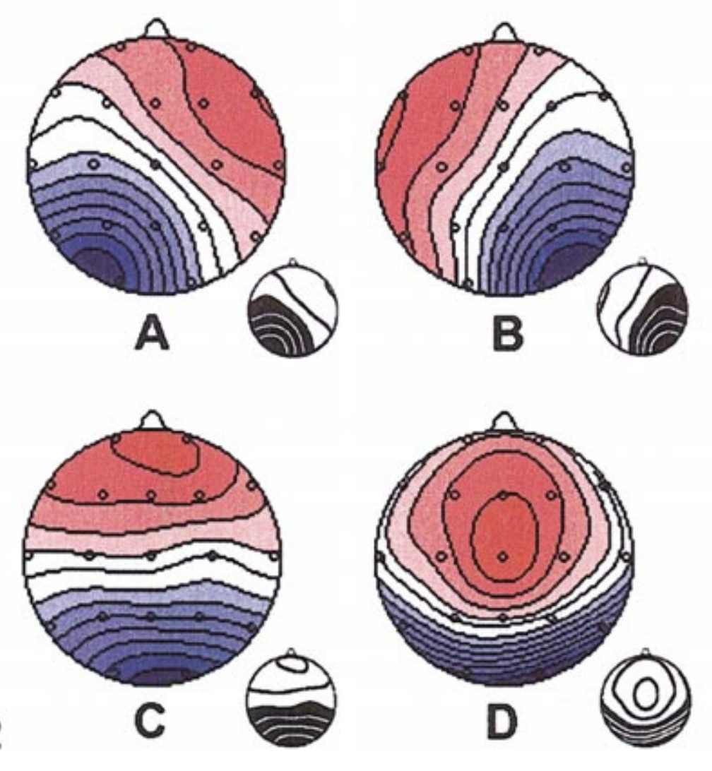
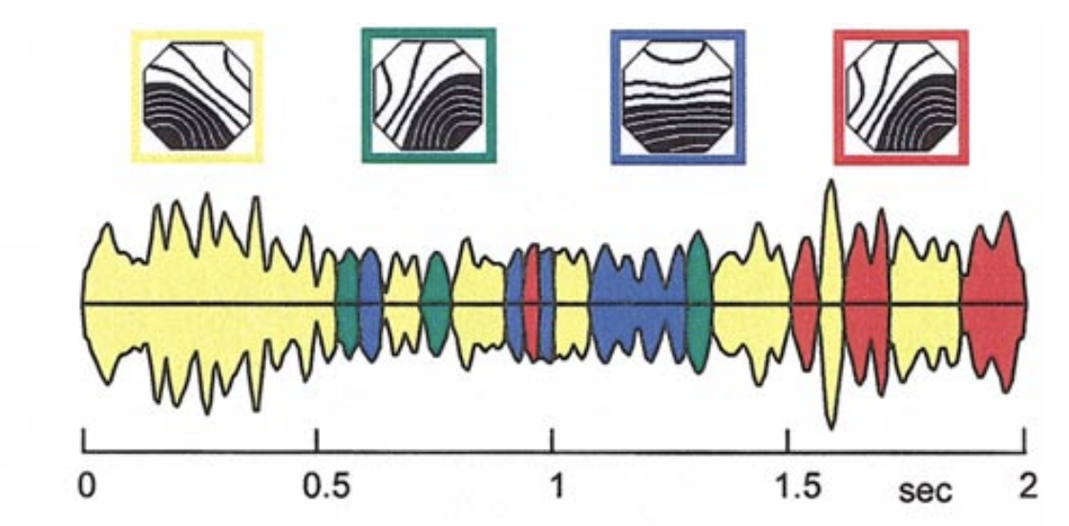
Methods: What is microstate?
EEG signals: electric potential on the scalp from neuronal networks
Microstates: short (80-100 ms) and stable EEG patterns
Microstates reflect brain activity and cognition
Microstates can be clustered by topography algorithms
Microstates reveal brain function and state changes
A: Right frontal left posterior
B: left frontal right posterior
C: Anterior-Posterior orientation
D: Dominant orientation in the occipital area
GFP calculation
GFP peak detection
Get topographies at the peaks
Topography clusterization
Signify synchronized neural activity
Metrics calculation
Ref: Wikipedia, Koenig, Thomas, et al. Neuroimage

Slide 4
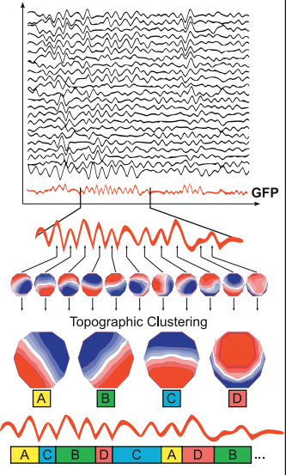
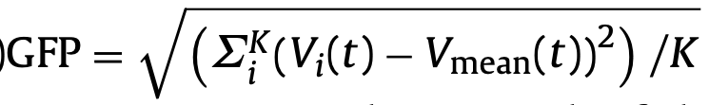
Methods: How to get microstate?
Step 1: Get the global field power, for K electrodes (can be from a frequency band)
In microstate analysis, the topographies of the electric field at local maxima of the GFP curve are considered discrete states of the EEG, and the evolution of the signal is considered as a series of these states
There are a large number of possible maps in multichannel recording, a majority of the signal (usually >70% of total topographic variance) is representable by just a few topographies.
These maps do not gradually morph into one another or overlap in time; instead, a single map remains dominant for about 80–120 ms before abruptly transitioning to another map [quasi-stability]
Ref: A. Khanna et al. Neuroscience and Biobehavioral Reviews Lehmann, D. Scholarpedia

Slide 5
Methods: How to get microstate?
Step 2: Clusterization
topographies at all GFP peaks are simultaneously extracted and entered into a clustering algorithm that groups these maps into a small set of classes based on topographic similarity, without regard to the order of their appearance; then,
the topography at each GFP peak is labeled as one of these classes, and the EEG signal is re-expressed as a sequence of microstate classes
(initially the approach was opposite where they cared about the order and didn’t cluster them)
Ref: A. Khanna et al. Neuroscience and Biobehavioral Reviews Lehmann, D. Scholarpedia

Slide 6
Methods: How to get microstate?
Step 3: Possible metrics
average duration or lifespan of each microstate
frequency of occurrence
coverage (the fraction of total recording time that the microstate is dominant)
topographical shape of the four microstate maps
amplitude of each microstate is the average GFP during microstate dominance
global explained variance of microstates is the percentage of total variance explained by a given microstate
transition probabilities of a microstate to any other
Ref: A. Khanna et al. Neuroscience and Biobehavioral Reviews Lehmann, D. Scholarpedia

